Slide 1

TAG 03/10/2021
3D Printing Parts from the McMaster-Carr Catalog

Slide 2
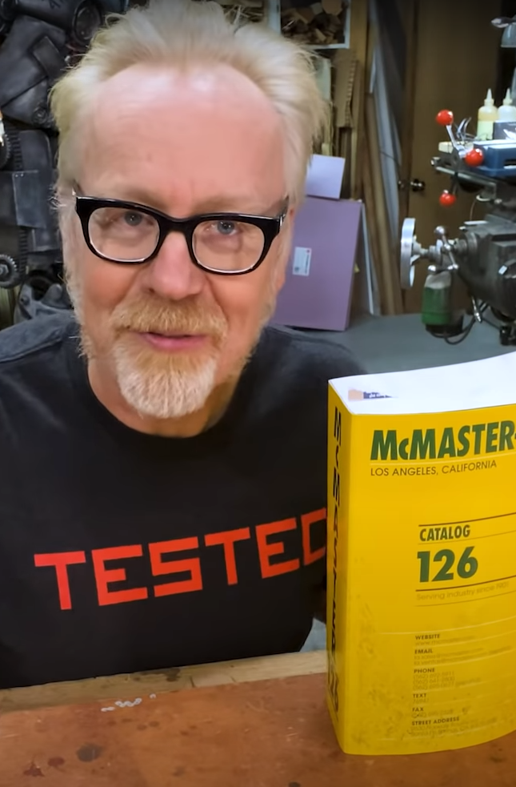
McMaster-Carr has 3D drawing of nearly all the industrial parts that they sell
Over the last decade, McMaster-Carr has added 3D models of most of their component parts to their vast catalog listings.
Presumably, the reason for this rather expensive marketing project is to get designers into the habit of using McMaster-Carr parts in their drawings and Bills of Material. There is a direct link in Autodesk's Fusion360 into the McMaster-Carr 3D models.
With minimal effort you can print these parts for prototypes.
Credit: Adam Savage video from YouTube

Slide 3
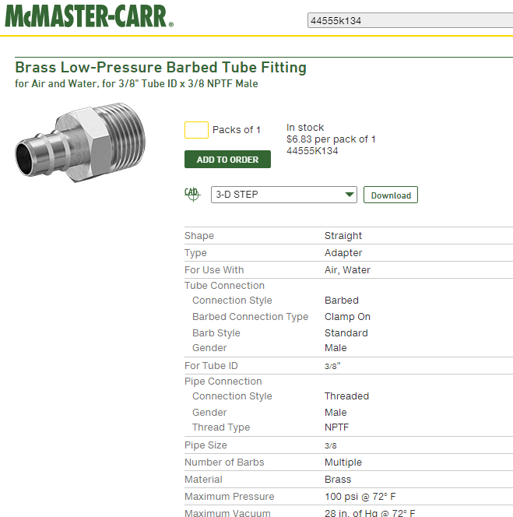
You can find a part, like a nut or a bolt in their on-line catalog and print it on a 3D printer for free.
3D models are available in several formats.
The easiest format to work with today is the STEP file. Most CAD Programs can import a STEP File.
The STEP file can be converted to an .stl file with Cad Assistant or many other cad packages. Cad Assistant is not open source, but it is free.
Credit: McMaster-Carr on-line catalog

Slide 4
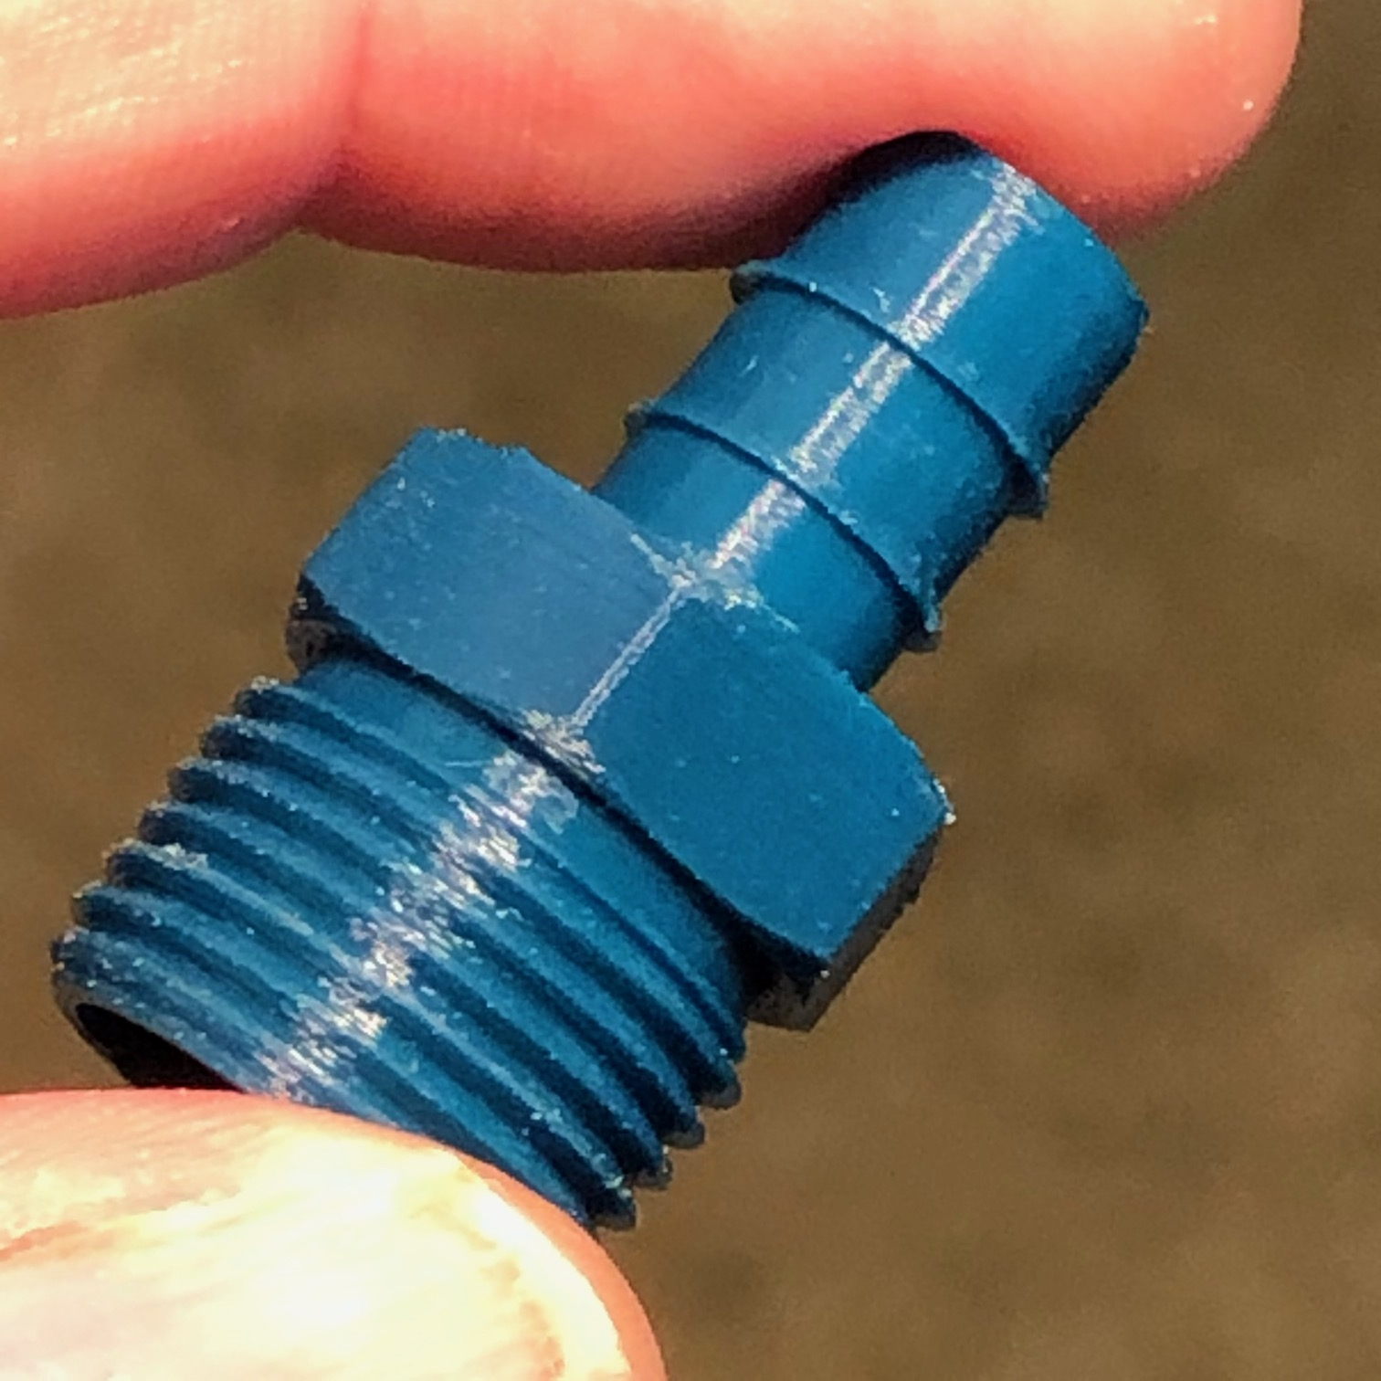
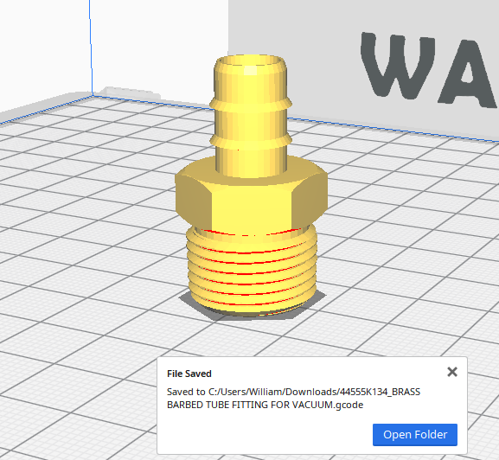
Here’s the Result

Slide 5
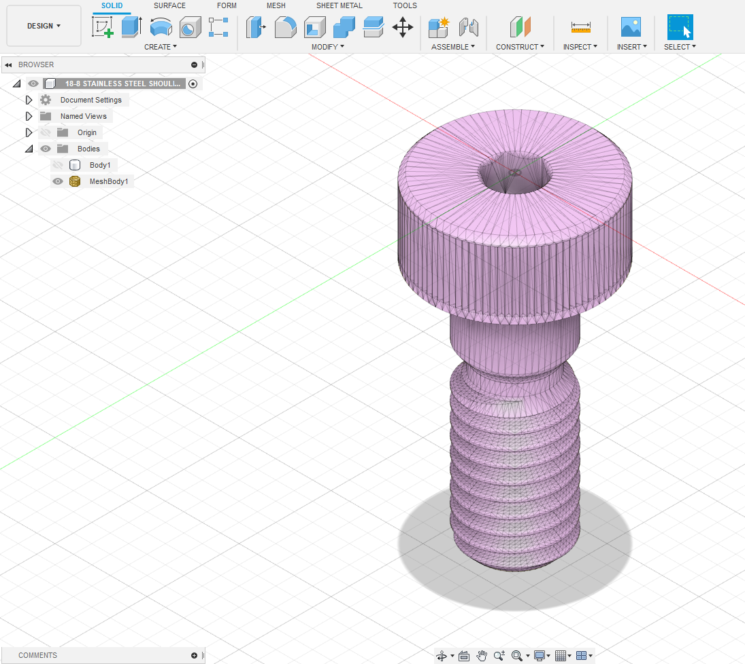
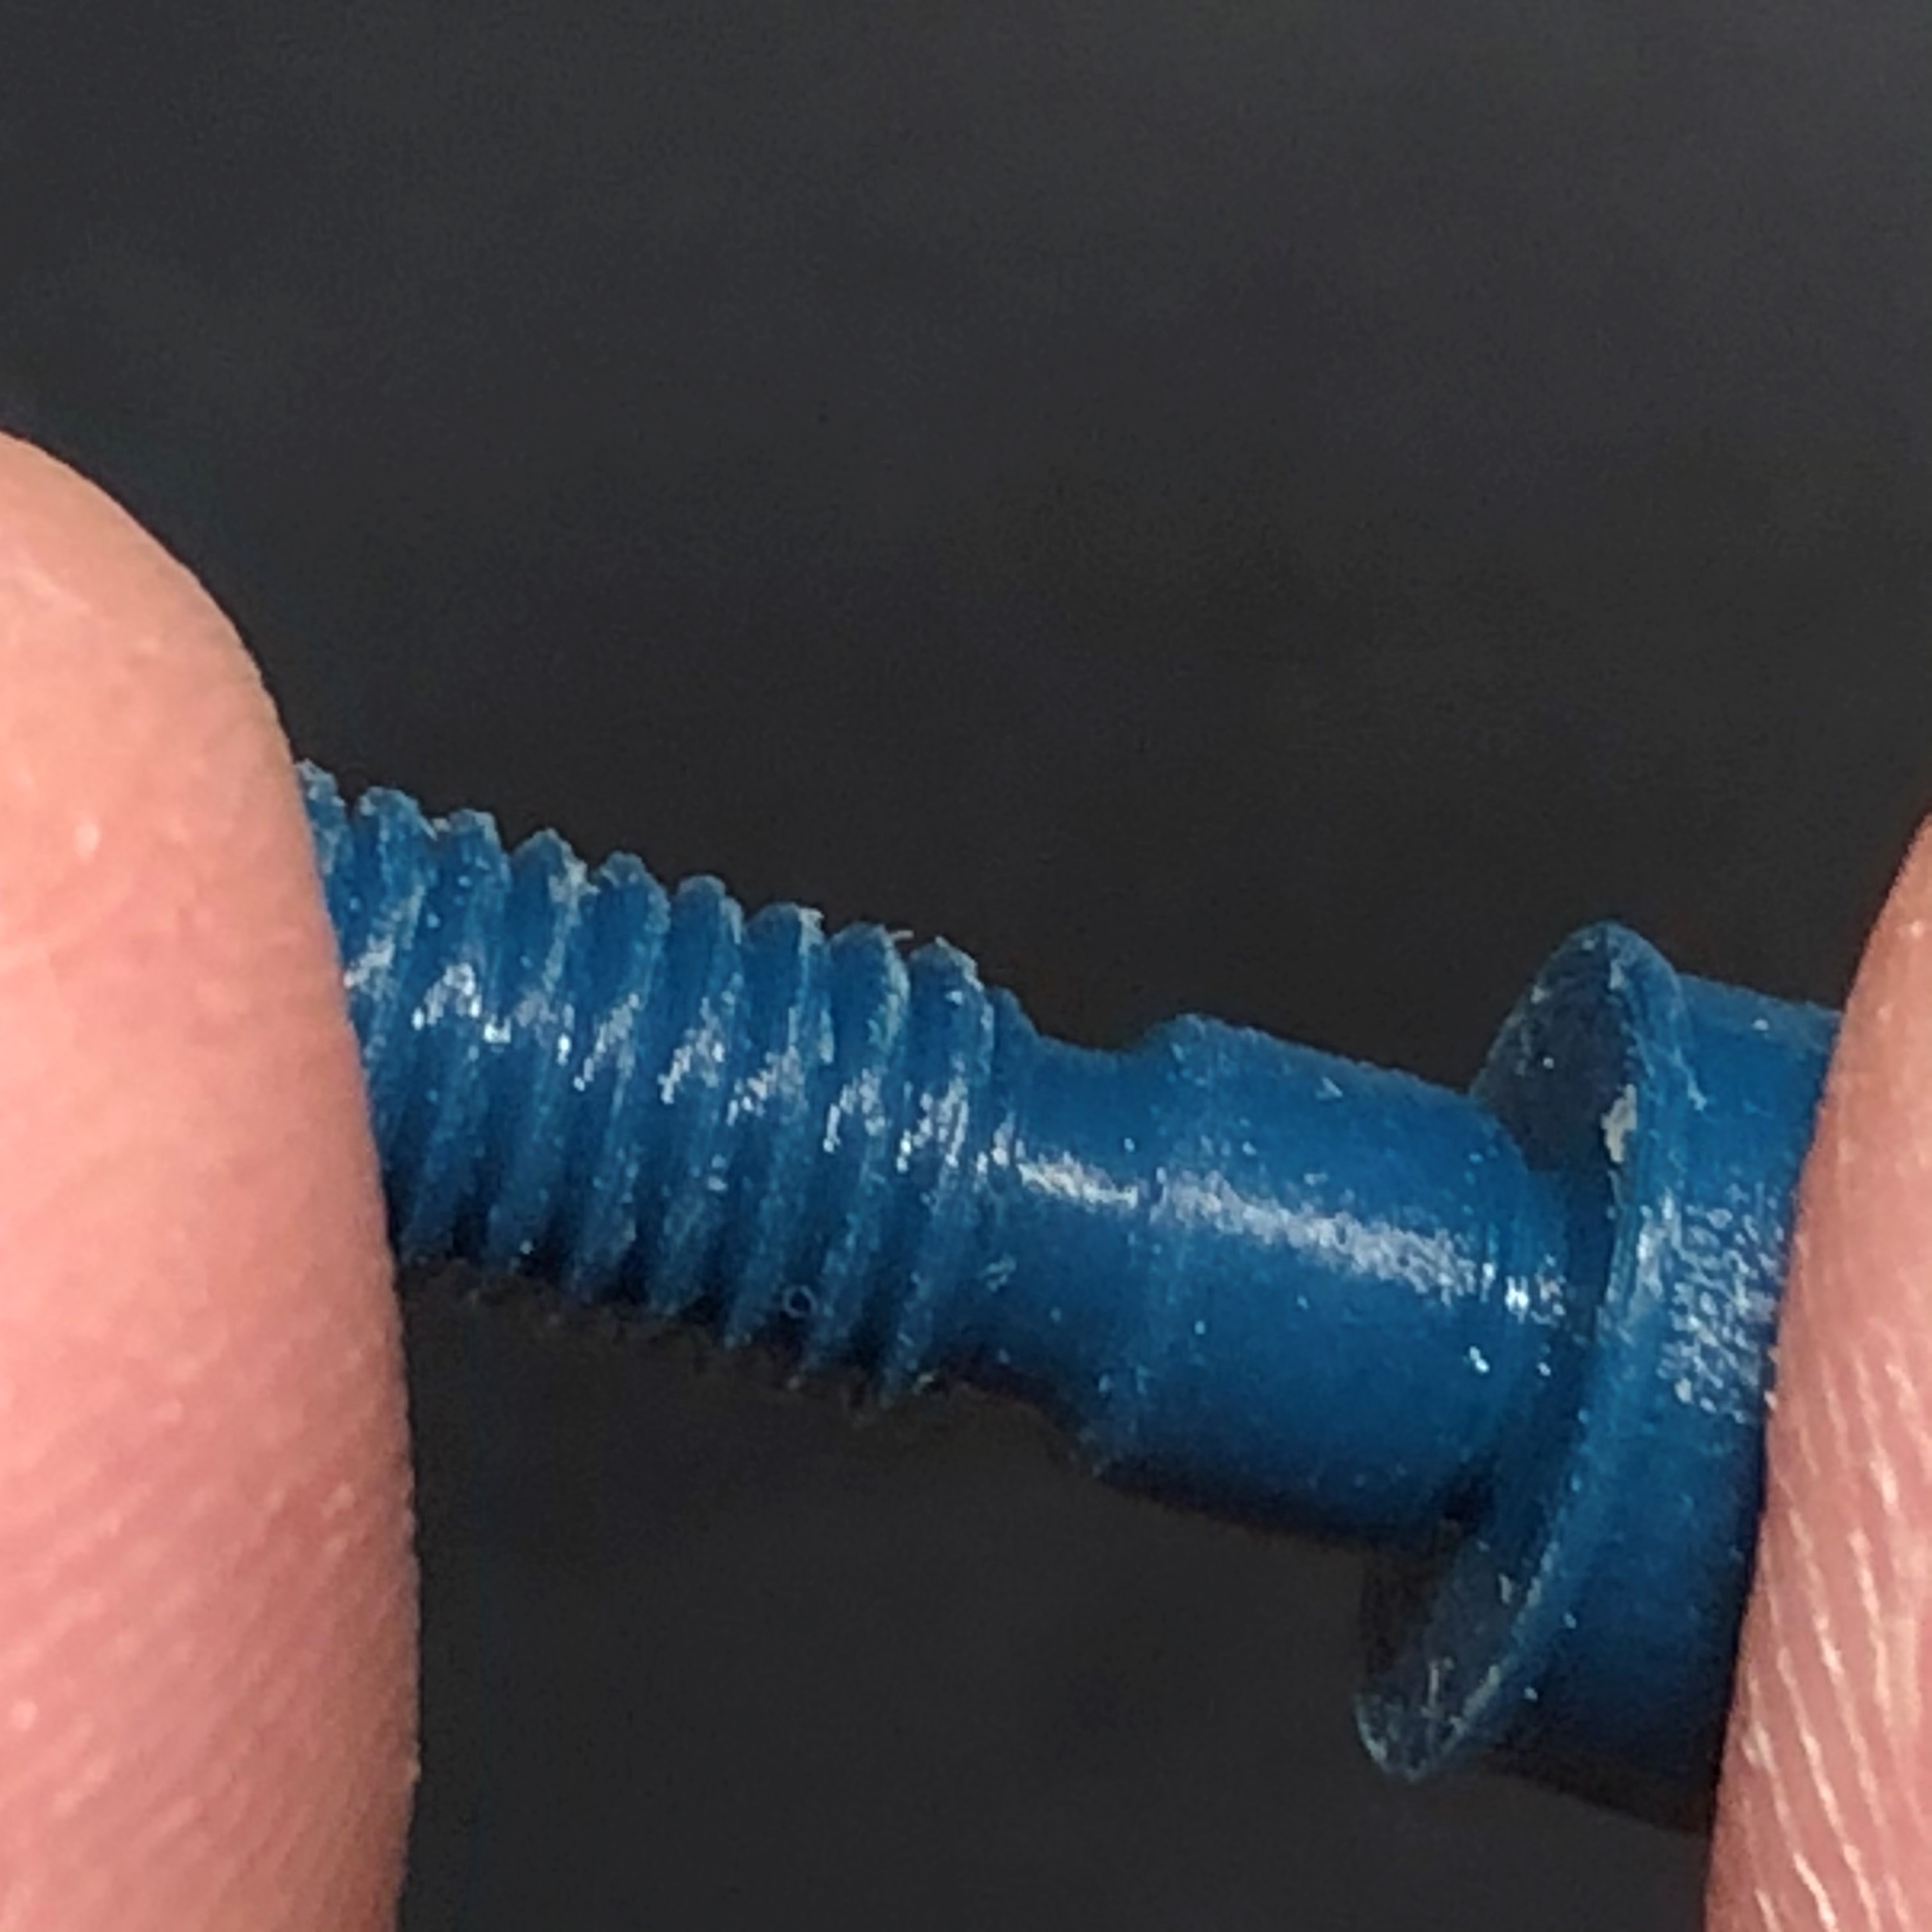
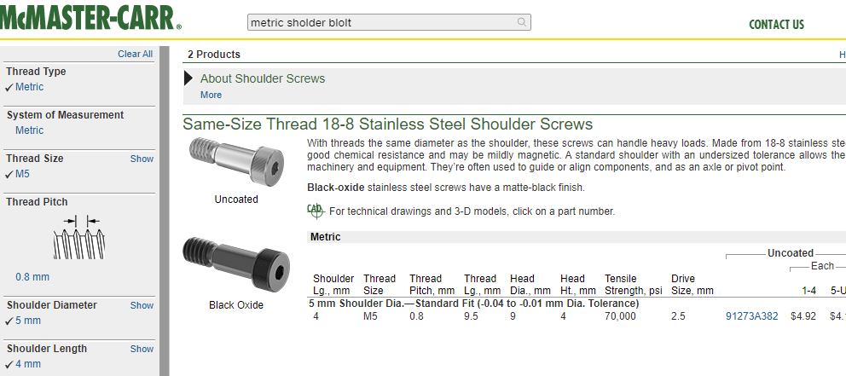
Another Example

Slide 6
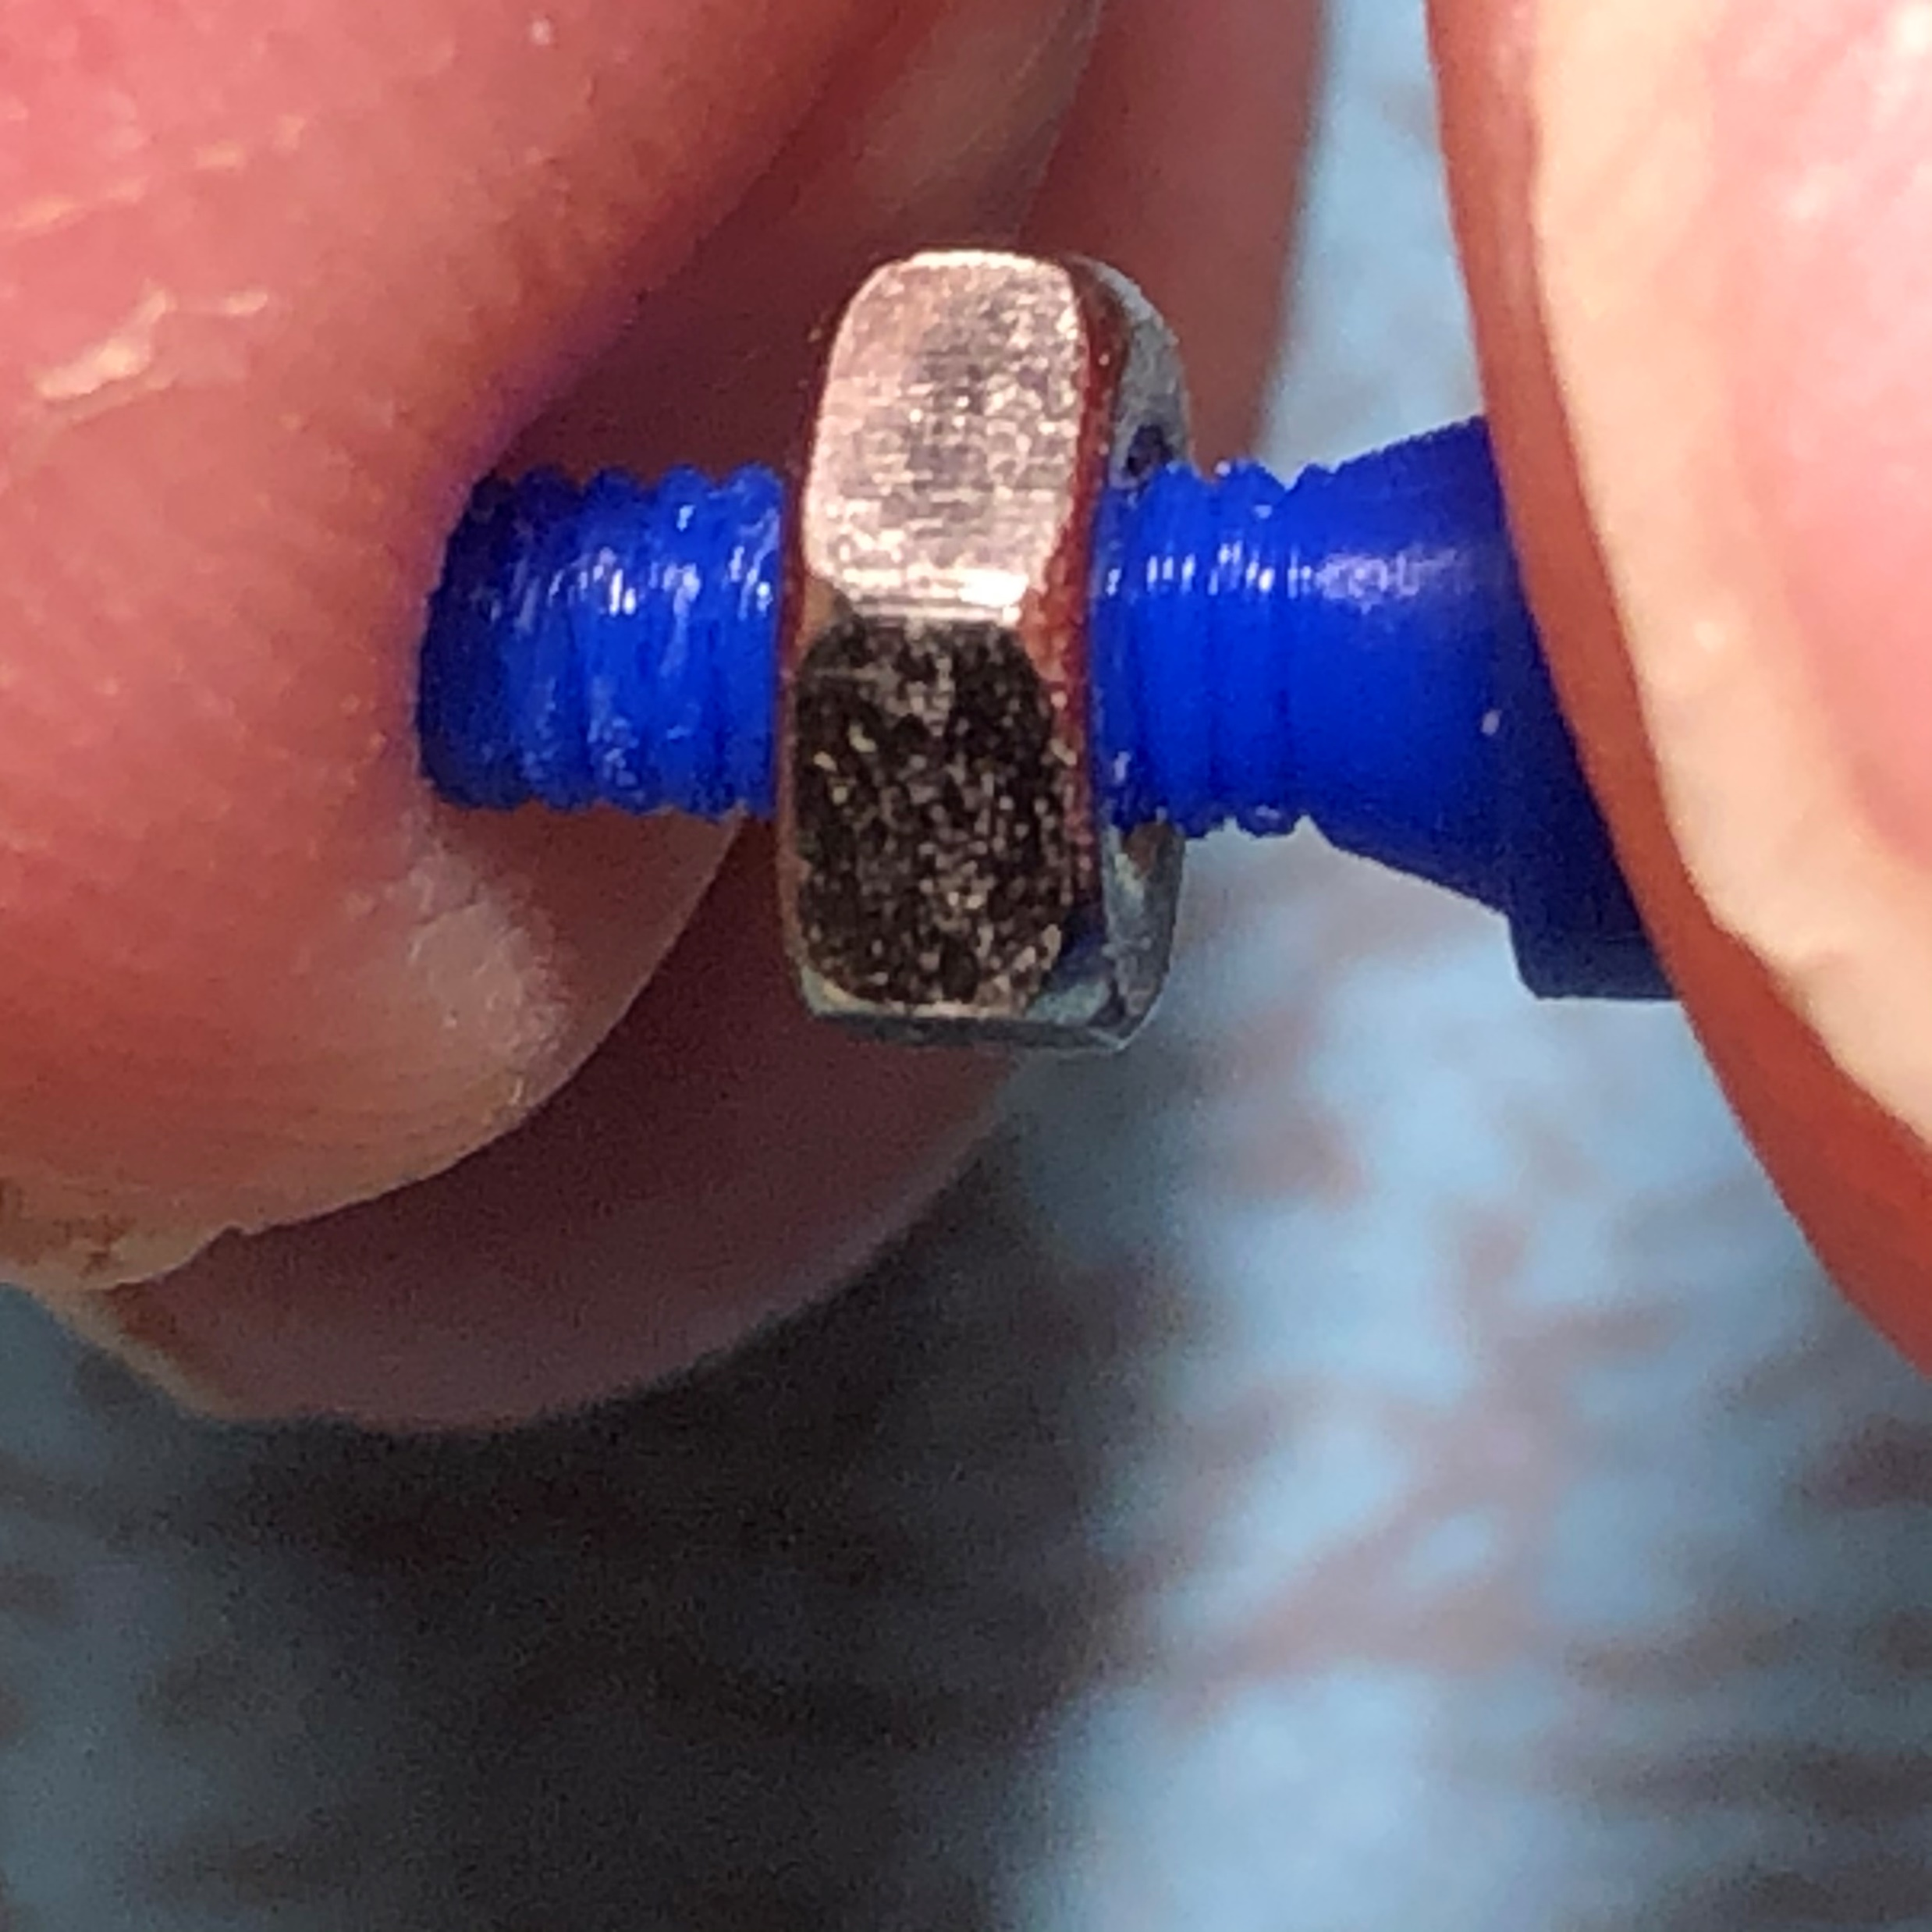
That’s it
I hope you found this interesting. Even if you don’t have any use for this now, you may in the future.
I am sure, buried in the fine print, there are significant restrictions on how McMaster-Carr allows their 3D models to be used.
Here is a link to this presentation.

